Slide 1
STABILITY 2

Slide 2


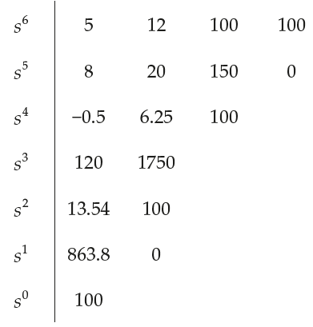


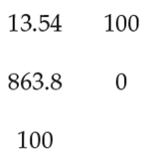
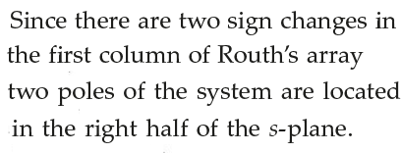

Problems in Routh Stability Criterion
2 5 37.5 0
30 437.5 0
Unstable System

Slide 3
Routh Array Construction
Case II:
First element in a row is zero, then the elements in the next row will be infinite…
To overcome this, let 0 -> Ɛ, and complete the construction of array.
Then substitute Ɛ as zero and check for stability.

Slide 4



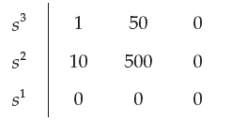
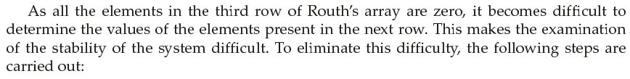
Problems in Routh Stability Criterion

Slide 5
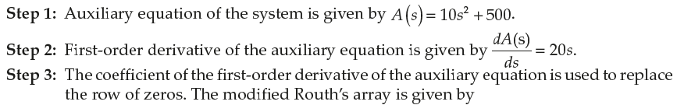
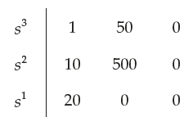
Problems in Routh Stability Criterion

Slide 6
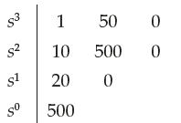
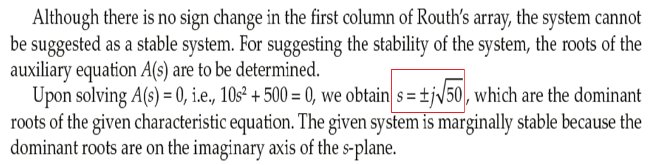
Problems in Routh Stability Criterion

Slide 7



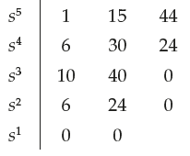
Problems in Routh Stability Criterion

Slide 8
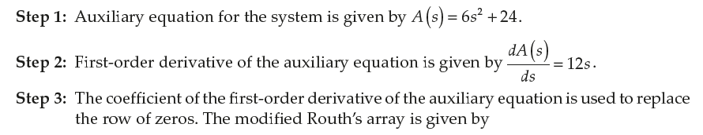
Problems in Routh Stability Criterion

Slide 9
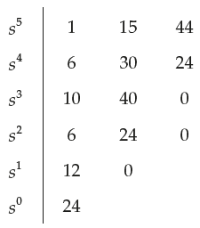
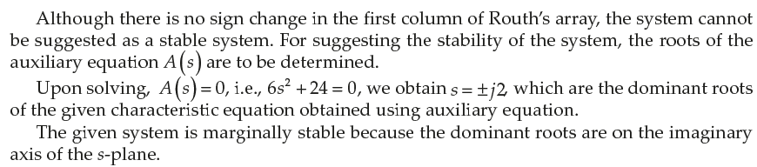
Problems in Routh Stability Criterion

Slide 10
Thank you

